Slide 1
Building systems
Shell
By: Francisco, Jose V, and Pedro.

Slide 2
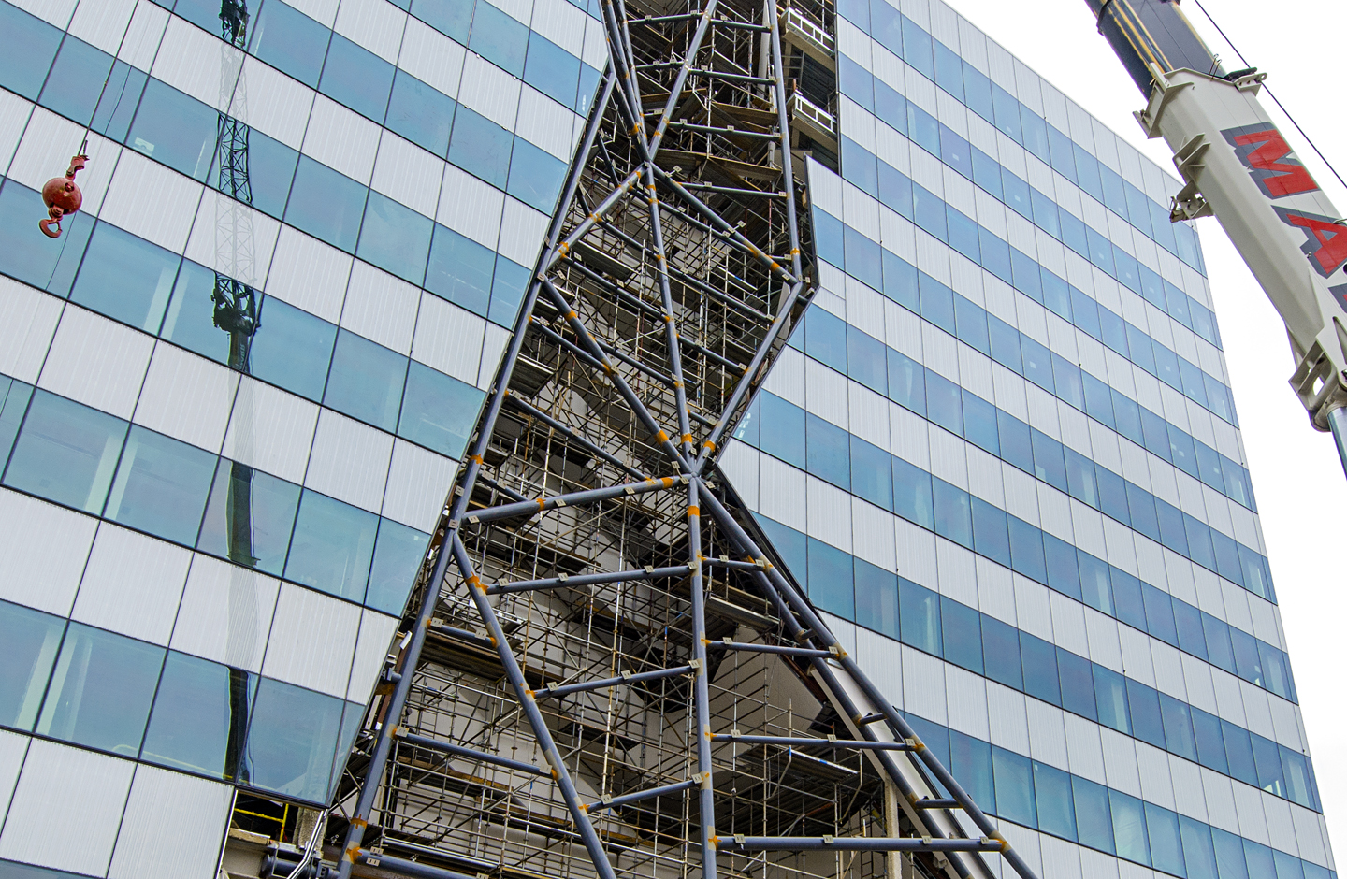
What is it?
The building shell is anything or all the components that separate the interior things with the exterior environment. This can include walls, windows, and anything that may be added to the shell.
Purpose: To make a safe and durable system that will prevent anything from the outside environment to enter the inside of a home.
Materials: Drywall, brick, wood, insulation, metals, and other materials.
Parts:
Walls
Windows
Doors
Roofing
Footers
Foundations

Slide 3
Cost of a shell
Cost is determined by the size an the region in which it’s in.
Commercial:
NY: $215
LA: $176.24
TX: $139.50
Convenience stores:
NY: $128
LA: $105.61
TX: $83.59
Fast food restaurants:
NY: $254
LA: $208.30
TX: $120.35

Slide 4
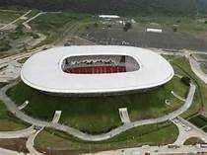
Loose constructed shells
A building shell is often categorized as open or closed
Older buildings will generally have an open shell, which means they are loosely constructed.
means that wind, moisture, and pests can enter and exit the building through cracks and other openings in the shell.
Loosely constructed buildings allow more air to enter and escape
means that fresh air is always passing into the space. So, conditioned air is able to freely exit
which results in poor energy efficiency and higher utility bills.

Slide 5
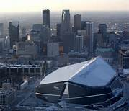
Tight constructed shells
Modern buildings are typically constructed more tightly, or closed.
making it easier to control interior conditions.
Both tight and loose building shells require a careful balance between energy efficiency and air quality.
Tight buildings let less air escape,
making them cheaper to heat or cool, fresh air has a harder time getting through a tight shell =in poor indoor air quality.

Slide 6
Green Solutions
Insulation Options:
Cellulose Insulation-
Pros:
Requires up to 30 times less energy to make than fiberglass and mineral wool.
At least 75% post- consumer recycled content (newspaper).
No effect on indoor air quality (treated with nontoxic borate).
Cons:
Can absorb moisture, can settle (if blown in dry).

